Slide 1


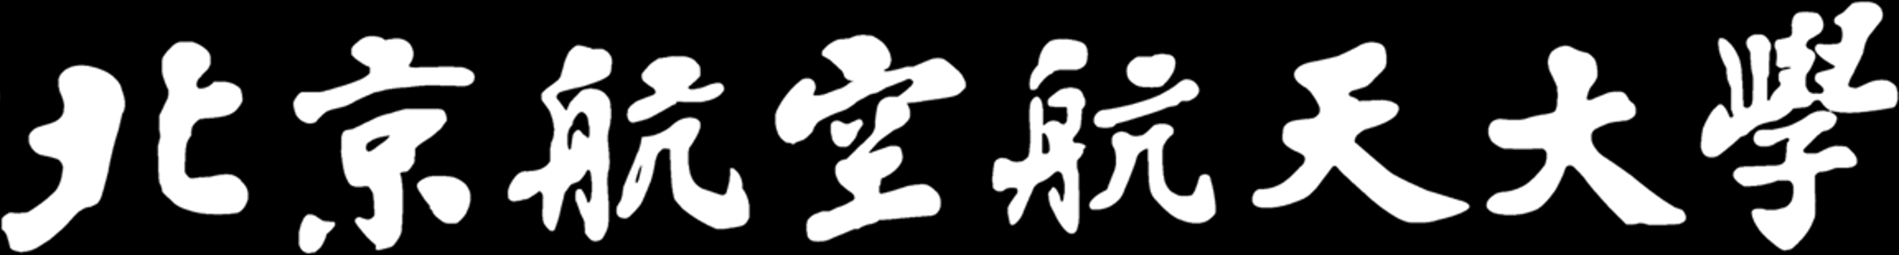
A Transformer-based Knowledge Graph Embedding Model Combining Graph Paths and Local Neighborhood
Beihang University
Tong Zhu, Huobin Tan, Xinyu Chen, and Yating Ren
School of Software
Beihang University, Beijing, China
Notes:
Good [morning/afternoon/evening] everyone, today I will be presenting our recent research findings in the field of Knowledge Graph Embedding. This work was conducted by our team at the School of Software, Beihang University.

Slide 2
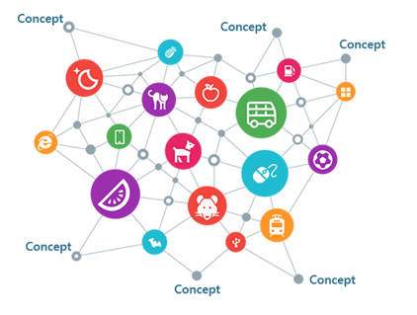



Introduction
Knowledge Graph
Completion
Knowledge Graph Embedding (KGE)
Projects entities and relations
into a low-dimensional vector space
Question Answering
Recommendation System
Sematic Search
Notes:
Before we dive into our research, let's briefly discuss the fundamental concept of Knowledge Graphs. Knowledge Graphs are structured knowledge bases that are extensively used in semantic search, question-answering systems, and recommendation systems, among other applications. Despite their utility, even large-scale Knowledge Graphs suffer from incompleteness, which restricts their real-world applications. As a result, Knowledge Graph Completion (KGC) has emerged as an active research area.

Slide 3
Existing KGE models
Early Models
Translation based, such as TransE, TransR, TransH
Tensor factorization based, such as DistMult, ComplEx
Convolutional neural networks (CNN) based, such as ConvE
Unable to utilize the graph structural information
Deep Models
Employ graph convolutional neural networks to leverage the local neighborhood structures of entity.
Restricted in expressiveness because of the shallow network architecture
The issue of over-smoothing further limits the model‘s ability in capturing long-distance information.

Slide 4
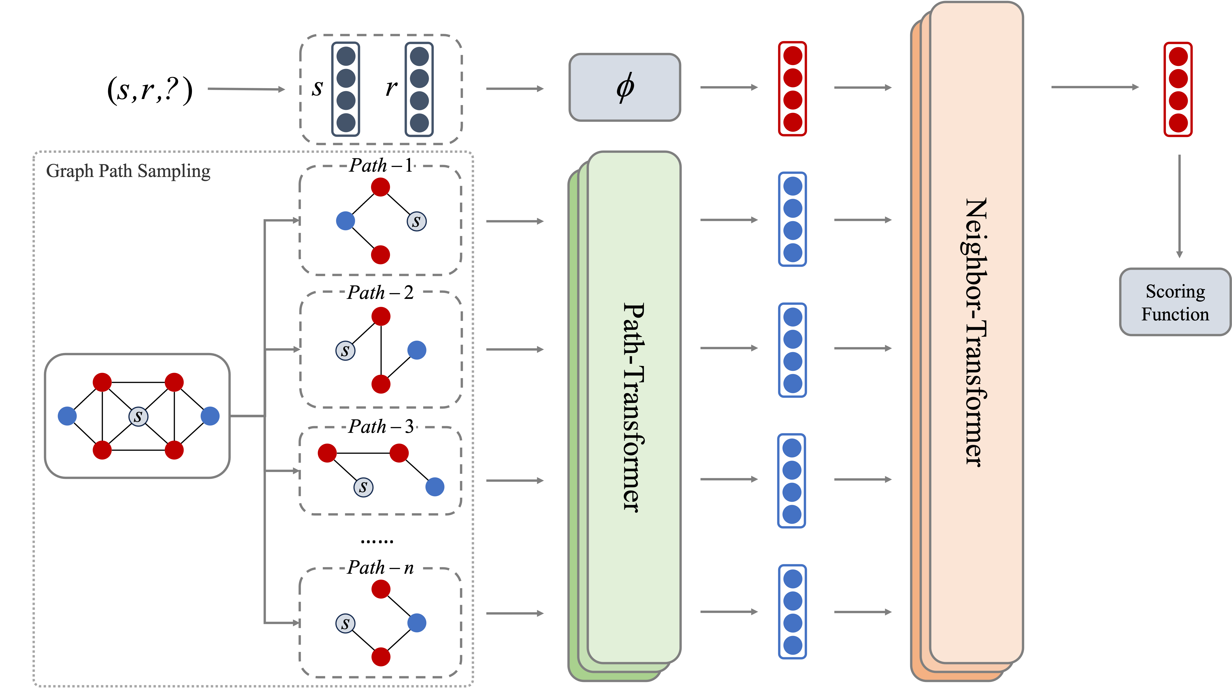
Our Solution: TKGE-PN
Transformer-based knowledge graph embedding method that combines graph paths and local neighborhood
Combine graph paths with local neighborhood
Better learn long-distance dependencies
avoiding the problem of over-smoothing
Transformer-based
Self-attention mechanism provides TKGE-PN a more powerful expressive capacity.

Slide 5
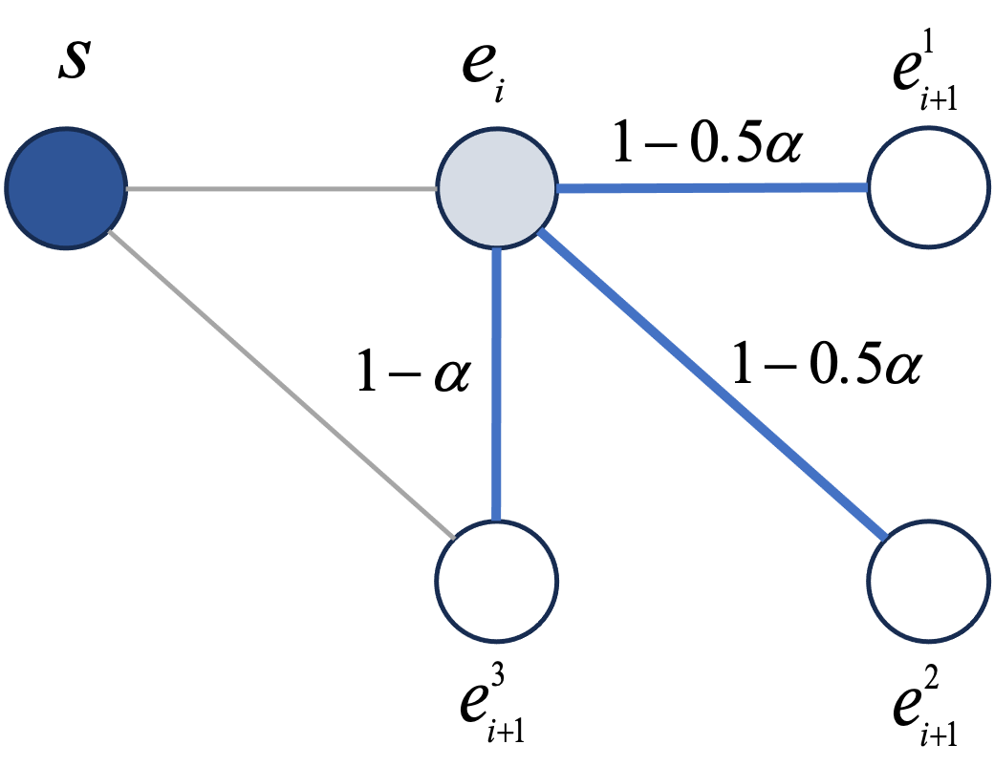
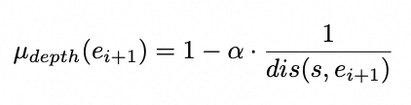
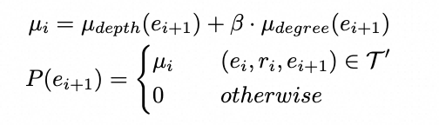
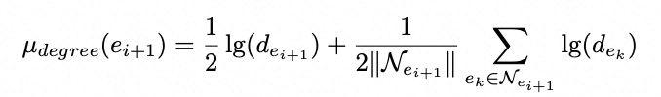
Biased Random Walk Graph Path Sampling
Problem-1
Impossible to traverse all graph paths within the graph
Samples a number of graph paths equal to the node degree of the central entity , rather than a fixed value.
Problem-2
Not all paths contribute meaningfully to high-quality knowledge graph embeddings.
Biased random walks
Depth bias
Degree bias
Notes:
Our approach begins with a biased random walk algorithm that samples multiple graph paths starting from the central entity.

Slide 6
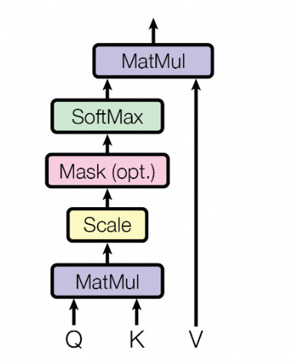
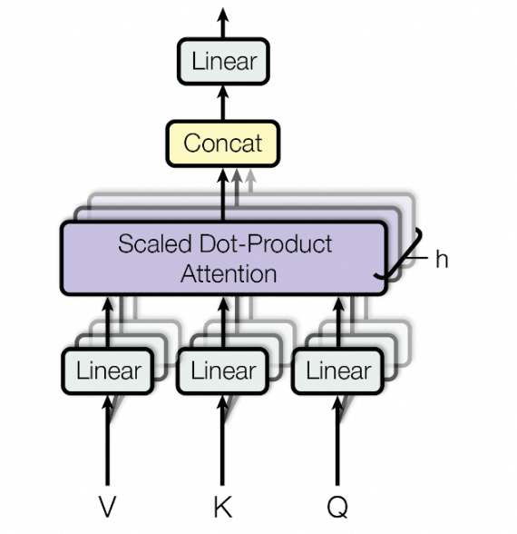
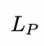
Path-Transformer
Path-Transformer
Use Transformer to
extract the semantic information.
Masked Entity and Relation Prediction
E_{PATH}
E_{MERP}
e₁
E_{CLS}
e_{s}
r₁
[mask]
r₂
e₂
Enhance the Path-Transformer’s ability
to extract information from path contexts.
Notes:
"The sampled paths are then encoded into vector representations by our Path-Transformer module. Utilizing the self-attention mechanism, it captures the nuanced interplay between entities and relations along each path."

Slide 7
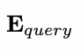
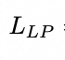
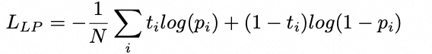
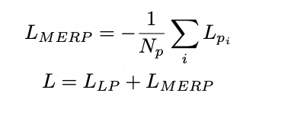
Neighbor-Transformer
Combine both local neighborhood information and graph path information
Graph paths cover the first-order neighborhood of the central entity
Model completes the learning of local neighborhood information while aggregating path information
Notes:
"The sampled paths are then encoded into vector representations by our Path-Transformer module. Utilizing the self-attention mechanism, it captures the nuanced interplay between entities and relations along each path."

Slide 8
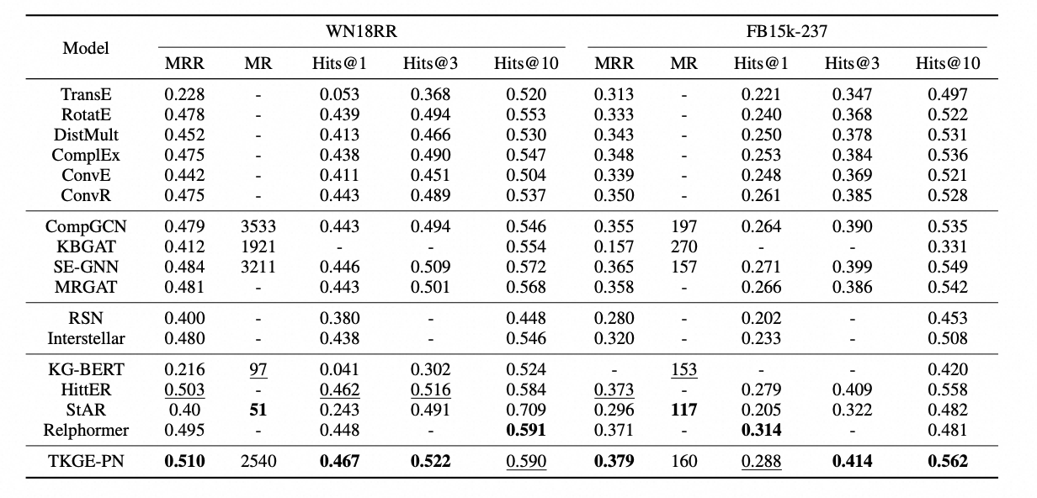
Experimental Results
Link Prediction Results:

Slide 9
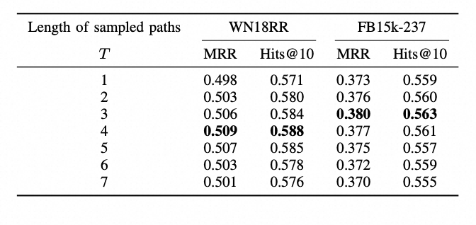
Link Predictions Results Under different Sample Length
Performance generally shows a trend of first increasing and then decreasing.
Performance discrepancy of the model on the two datasets is due to the varying sparsity levels of the datasets

Slide 10
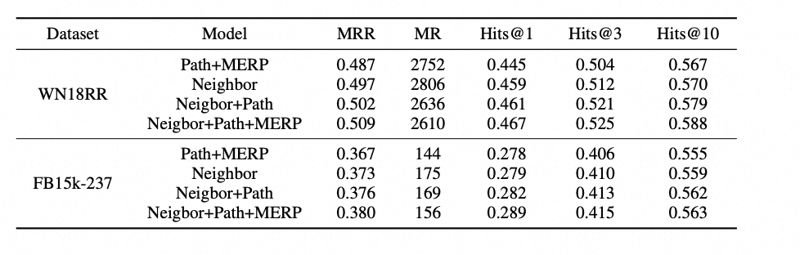
Ablation Study
Removal of either the local neighborhood encoding module or the graph path encoding module results in a noticeable decrease in the performance
Addition of graph path information without the masked entity-relation prediction task does not lead to a significant improvement in performance.

Slide 11
Conclusion
Contribution
In this paper, we proposed TKGE-PN,which achieves a comprehensive learning of both short and long-distance dependencies by fusing two types of structural information from knowledge graphs.
Conduct experiment on two dataset and demonstrate the effectiveness of our approach.
Thank you for attention!

